Slide 1
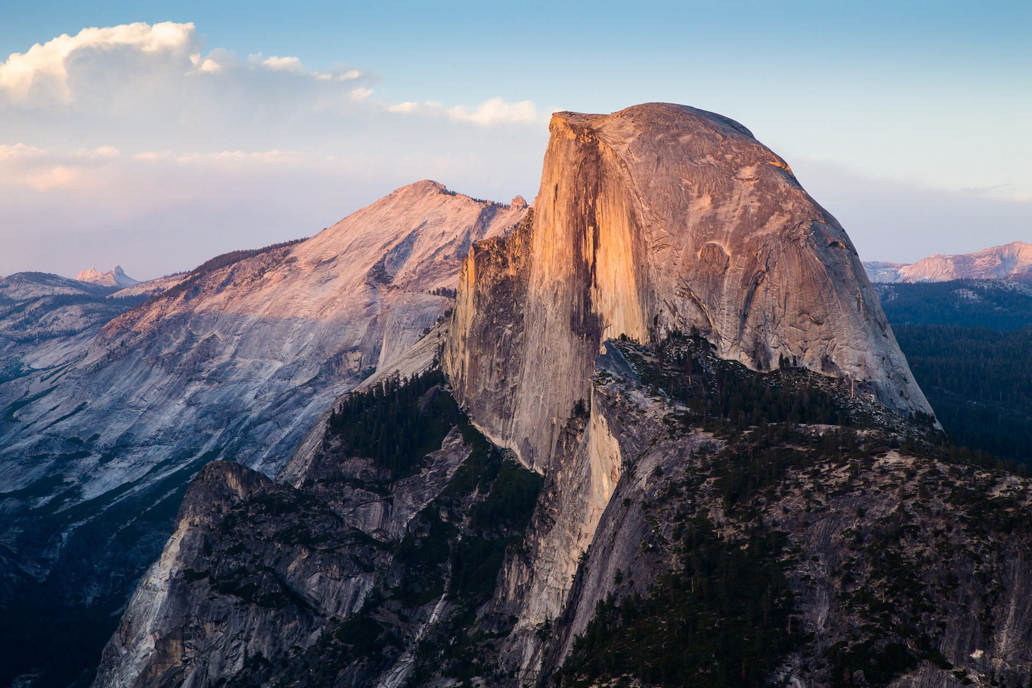
WHERE IN THE WORLD SHOULD
YOU CLIMB NEXT?
INTERNATIONAL ROCK CLIMBING CLIMBING RECOMMENDATION SYSTEM
An exercise in user-based collaborative filtering
Kristen N. Colley

Slide 2
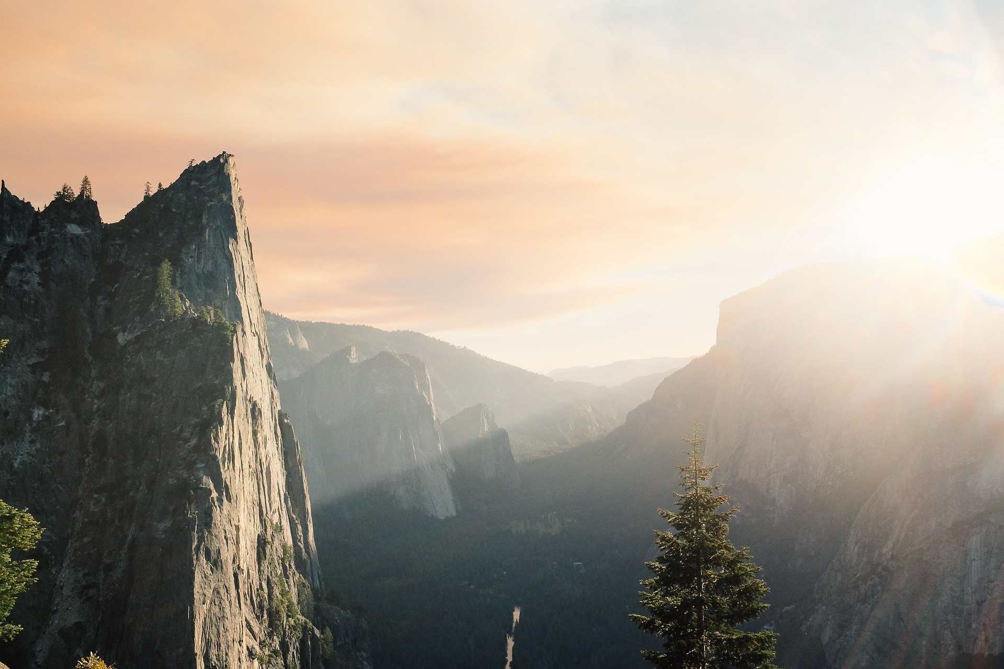
WHY?
The sport of rock climbing has been steadily increasing in popularity. From 2012-2017, the IBISWorld estimates that from average annual growth for the indoor climbing wall industry was 3.9% in the USA. In 2015, it ranked 17th out of 111 out of the most popular sports in the United States ( Physical Activity Council and PHIT America).
Yet, even with this growth in popularity, most of the international rock climbing websites still lack a rock climbing recommendation system. In this project, I will create a recommendation system for the 8a.nu website that will help climbers identify some unique international climbing objectives.

Slide 3
DATA
8a.nu is one the world’s largest international rock climbing websites. With over 4 million entries of climbs and ratings, this Kaggle webscraping project is a sufficient size to develop a good predictor model. To view the 8a.nu website, the original Kaggle four SQLite tables created by David Cohen, or the import report using the Kaggle API click on the links below:
8a.nu website
Kaggle Dataset
Data Import Report

Slide 4
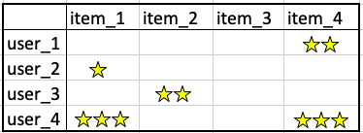
METHOD
There are three main types of recommenders used in practice:
Content-based filter: Recommending future items to the user that have similar innate features with previously "liked" items.
Collaborative-based filter: Recommending products based on a similar user that has already rated the product.
Hybrid Method: Leverages both content & collaborative based filtering.
WINNER: User-based collaborative-filtering

Slide 5
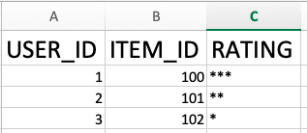
DATA
CLEANING
Full Data Cleaning Report
Larger Issues Encountered:
Problem 1:This dataset is all user-entered information and subject to invalid information
Solution: groupby three reference columns and imput the mode of the column to increase the accuracy of the dataset
Problem 2: Being this is an international rock climbing website, the names of the rock climbing routes were differing based on if the user enters accent marks or not.
Solution: normalize all names to the ascii standards.
Problem 3: Spelling issues with the route names. For example: if there was a route named "red rocks canyon" it could be spelled "red rock", "red rocks", "red canyon" etc.
Solution: I tried phonetic spelling algorithms (soundex & double metahpone). However, my final solution was to create an accurate filter for route names. The logic being that if up to x number of users all entered that *exact same* route name, the chances were good that it was an actual route spelled correctly.

Slide 6
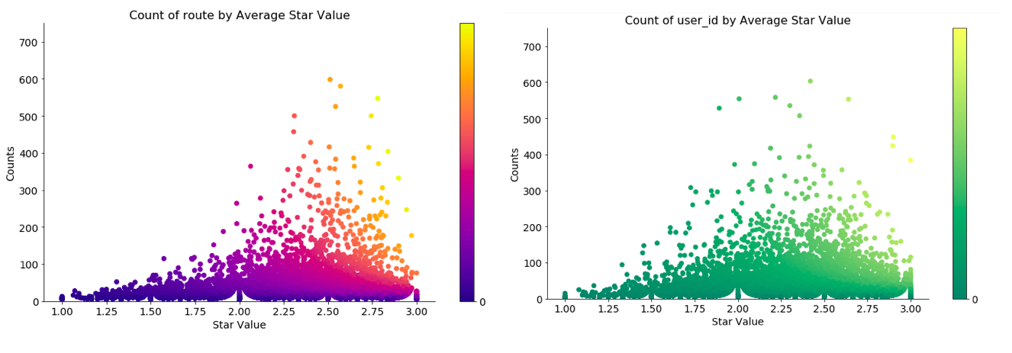
EDA
Full EDA Report

Slide 7
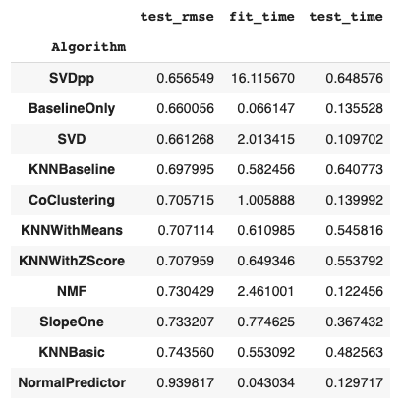
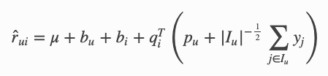
Machine Learning Report
ALGORITHMS
I tested four different filtered datasets on the 11 surprise library recommendation algorithms:
WINNER:
SVD++ Algorithm
This algorithm is an improved version of the SVD algorithm that Simon Funk popularized in the million dollar Netflix competition that also takes into account implicit ratings (yj).

Slide 8
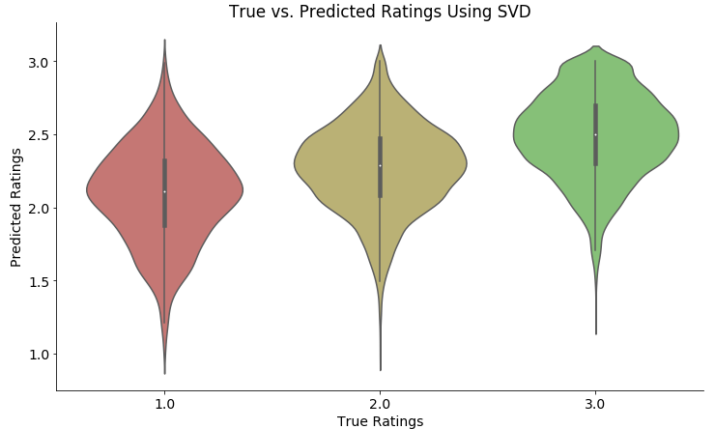
Accuracy
Machine Learning Report

Slide 9
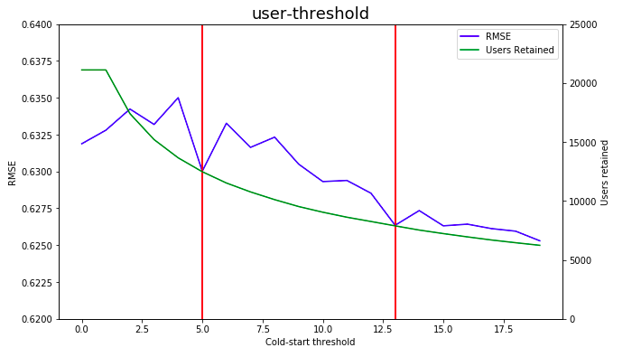
Cold-Start
Threshold
Machine Learning Report
What is it? When only using collaborative based filtering there is a problem to consider: what to recommend to new users with very little or no prior data?
Remember, to fix the spelling issue we already set the route cold-start threshold by choosing the dataset that filtered out any route occurring less than 6 times.

Slide 10
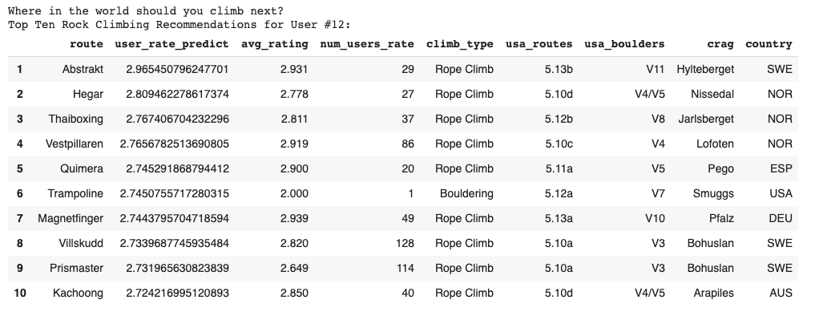
Predictions Notebook
Predictions
In the final predictions notebook, the user can enter their user_id number and receive a list of top ten routes recommended to them

Slide 11
Future
Improvements
Create a filtering system, wherein a climber could filter out the type, difficulty of climb, & country before receiving their top ten recommendation
Connecting to the 8a.nu website so that the user could input their actual online ID instead of just their user_id number
Due to RAM constraints on google colab, I had to train a 65% sample of the original 6x dataset. Without resource limitations, I would train on the full dataset. Preliminary tests showed that the bigger the training size, the lower the RMSE. One test showed an increase in sample size could increase the RMSE by .03 (in contrast to the .005 improvement I received when increasing the coldstart threshold)

Slide 12
NOW GET OUTSIDE AND CLIMB!
Kristen N. Colley

